Slide 1


Slide 2
Gertie, wake up! You’ve gotta head down to Beckley Park for your big day!”

Slide 3
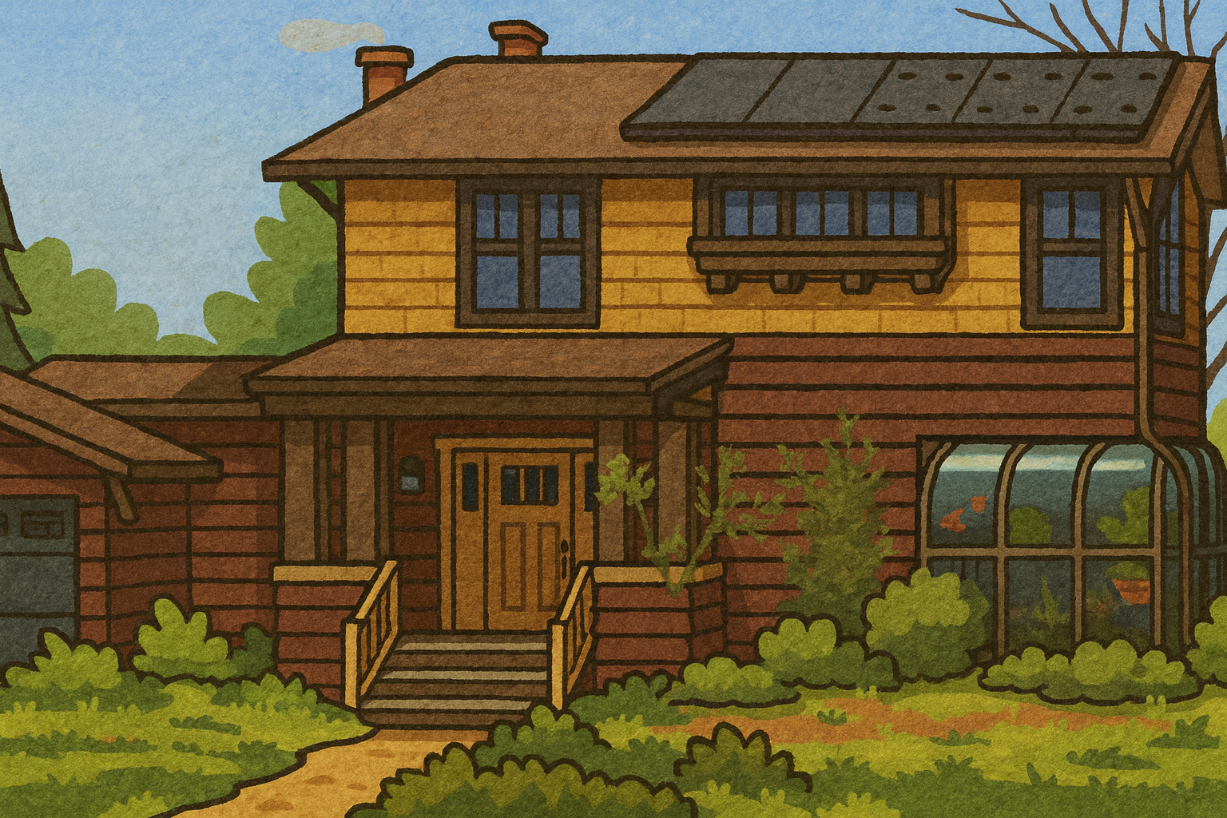
It’s Grandpa!
“I can’t remember how many leashes I need, can you help me count the dogs?”
DAD
DOGS (RGLM)

Slide 4
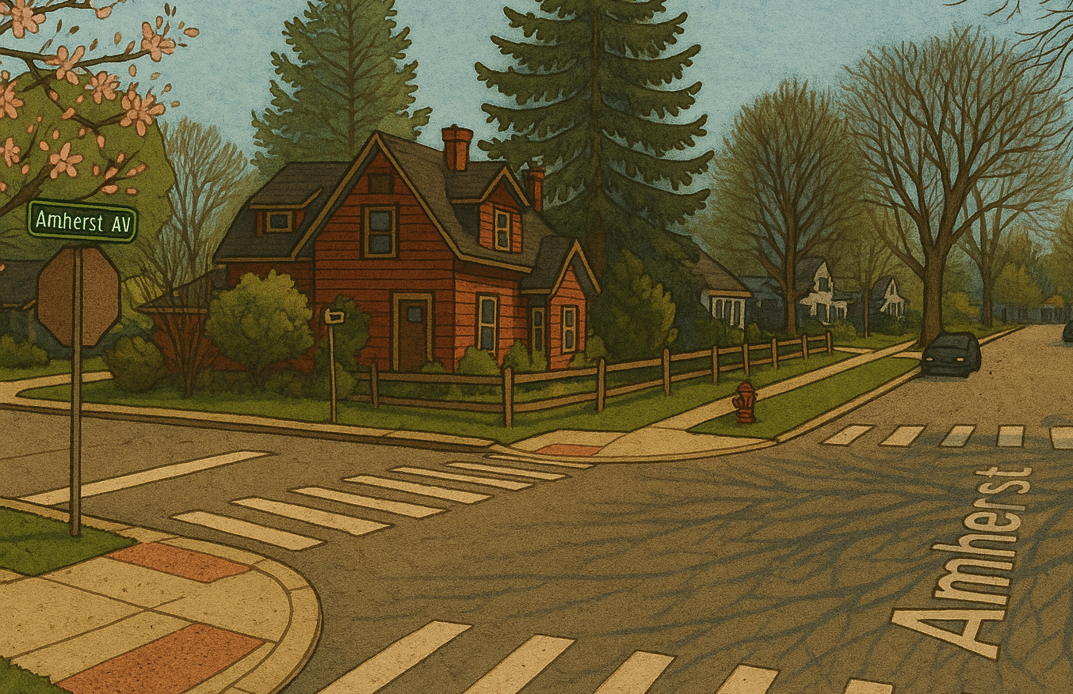
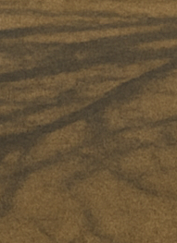
It’s Spike the cat! Let’s pet Spike
Spike

Slide 5
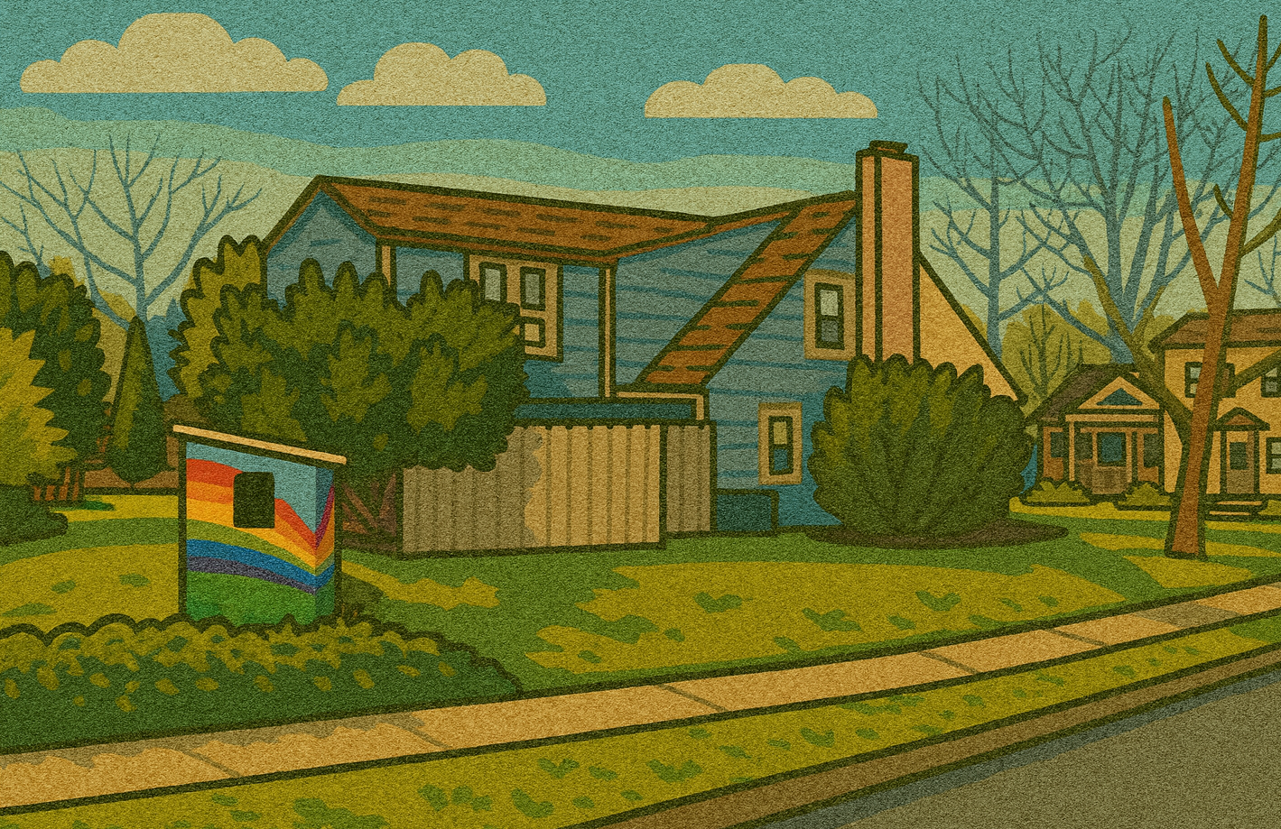
It’s the Kramer’s House! They lost an egg, can you help them find it?
Egg

Slide 6
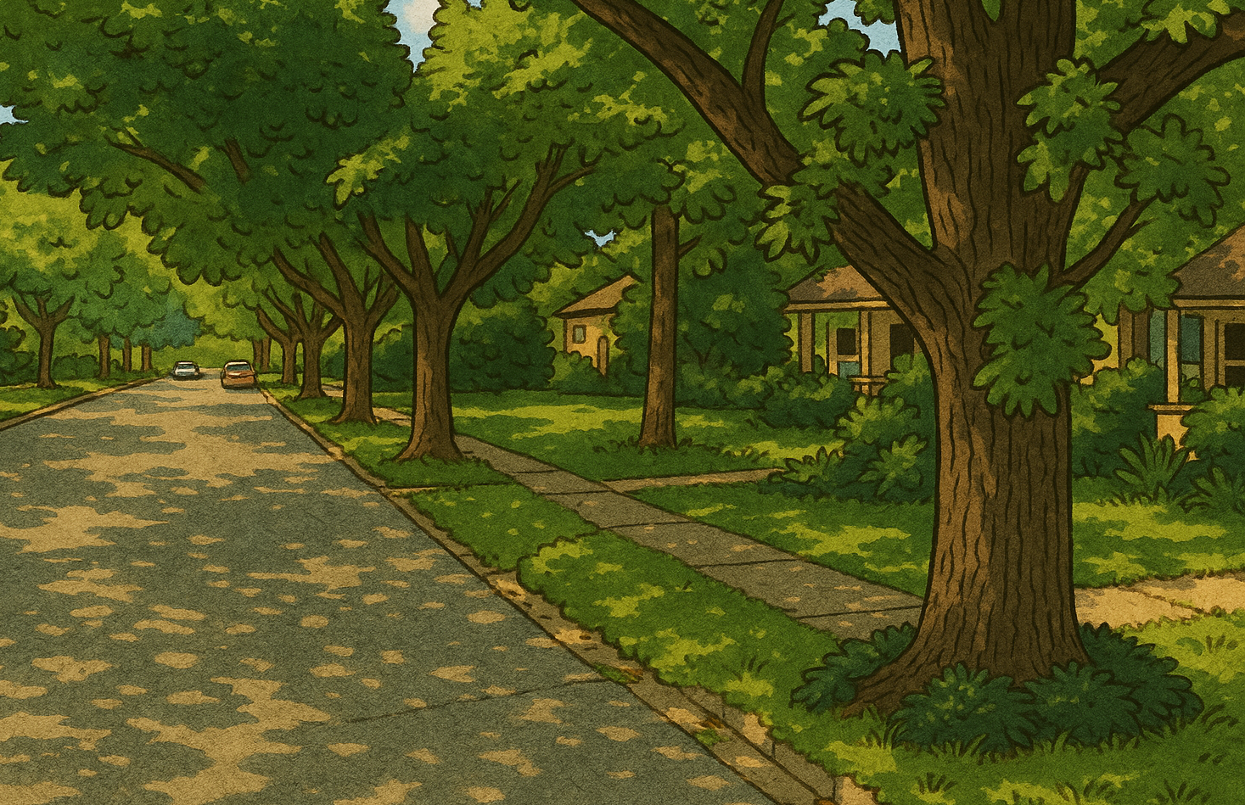
It’s Grandma! “I know that Beckley is just down the road here Gertie, but we’ve gotta study this cool mushroom. Can you find another way around?”
Scientist4
Mushroom
Scientist2
Scientist3
Mom
Scientist1

Slide 7
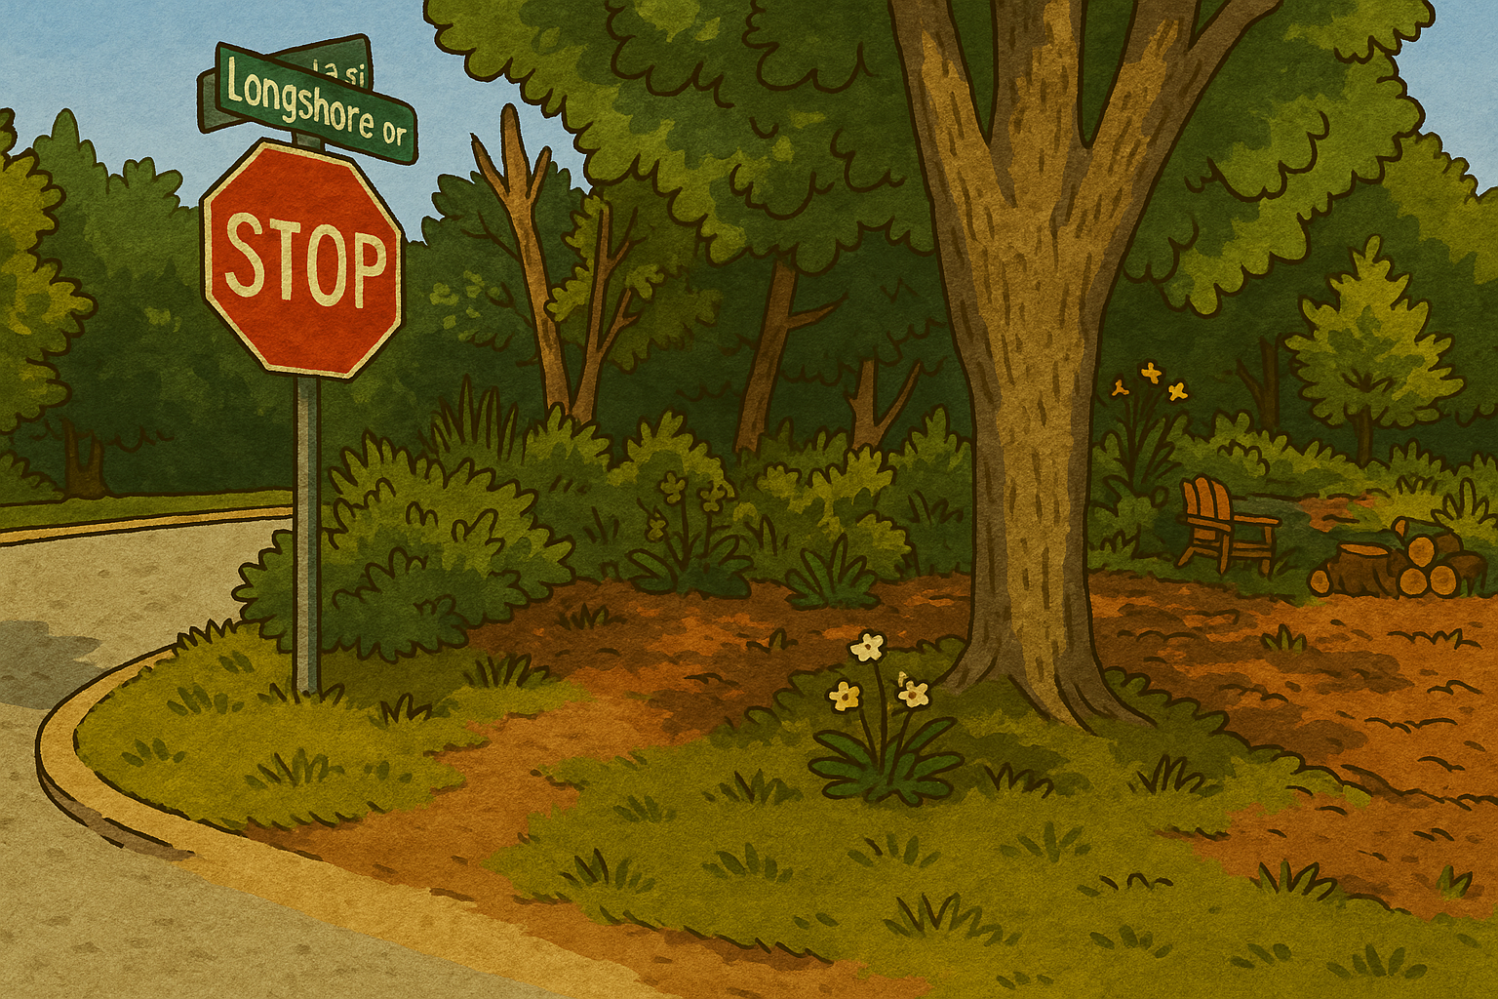
I think I see a skunk in the bushes! Let’s watch out for that

Slide 8
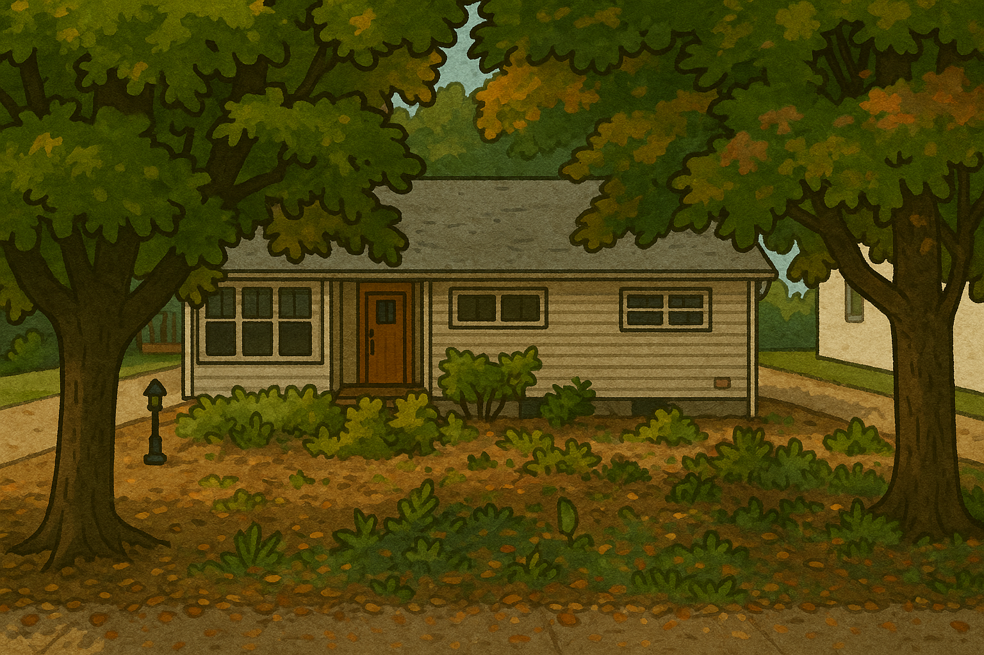

It’s Brooklyn! He must have taken himself for a walk down to his friend Hazel’s house

Slide 9
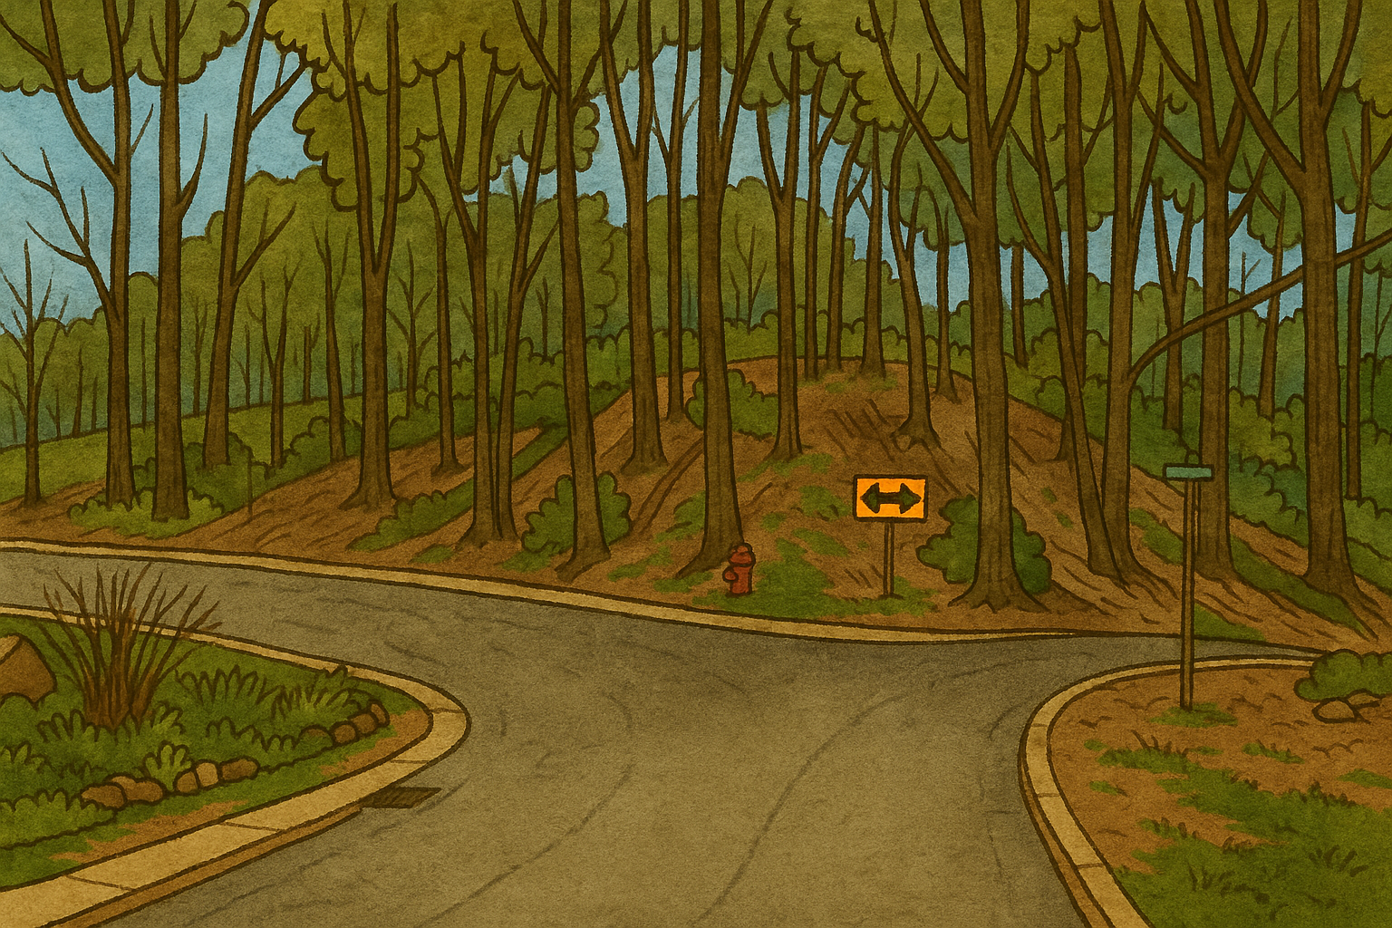
There’s a fork in the road! I think I see some balloons out to the left, though!
Party equipment

Slide 10
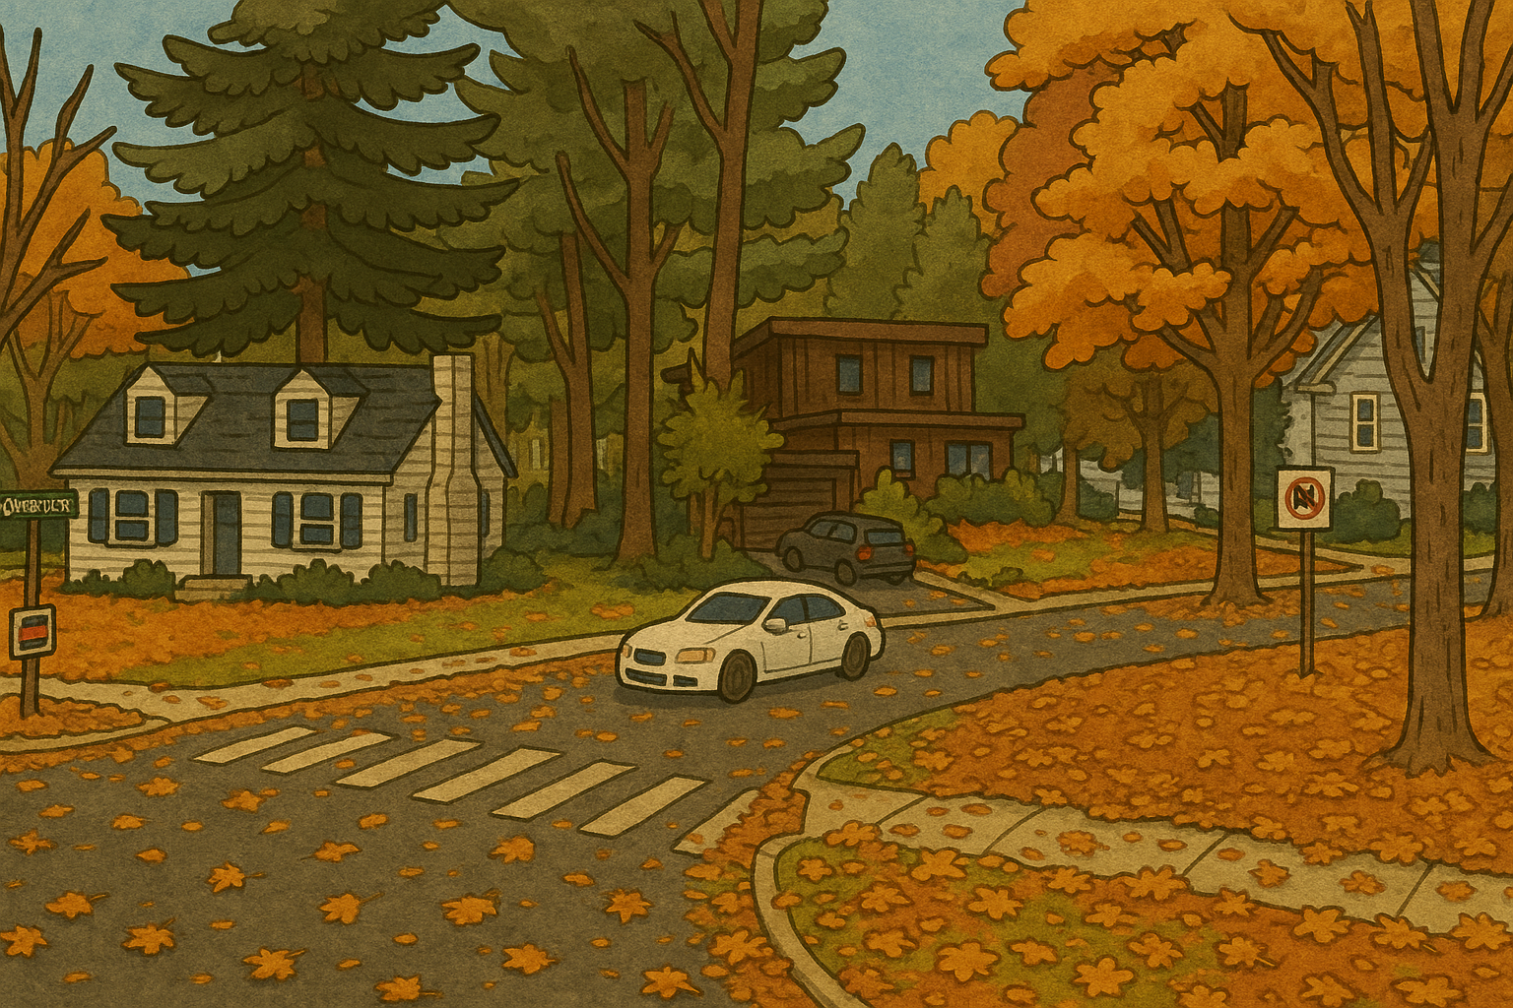


Aunt Marge is blowing up like a balloon! Oh wait, that’s just a big balloon of Aunt Marge and Uncle Tommy is carrying it down to the park!

Slide 11
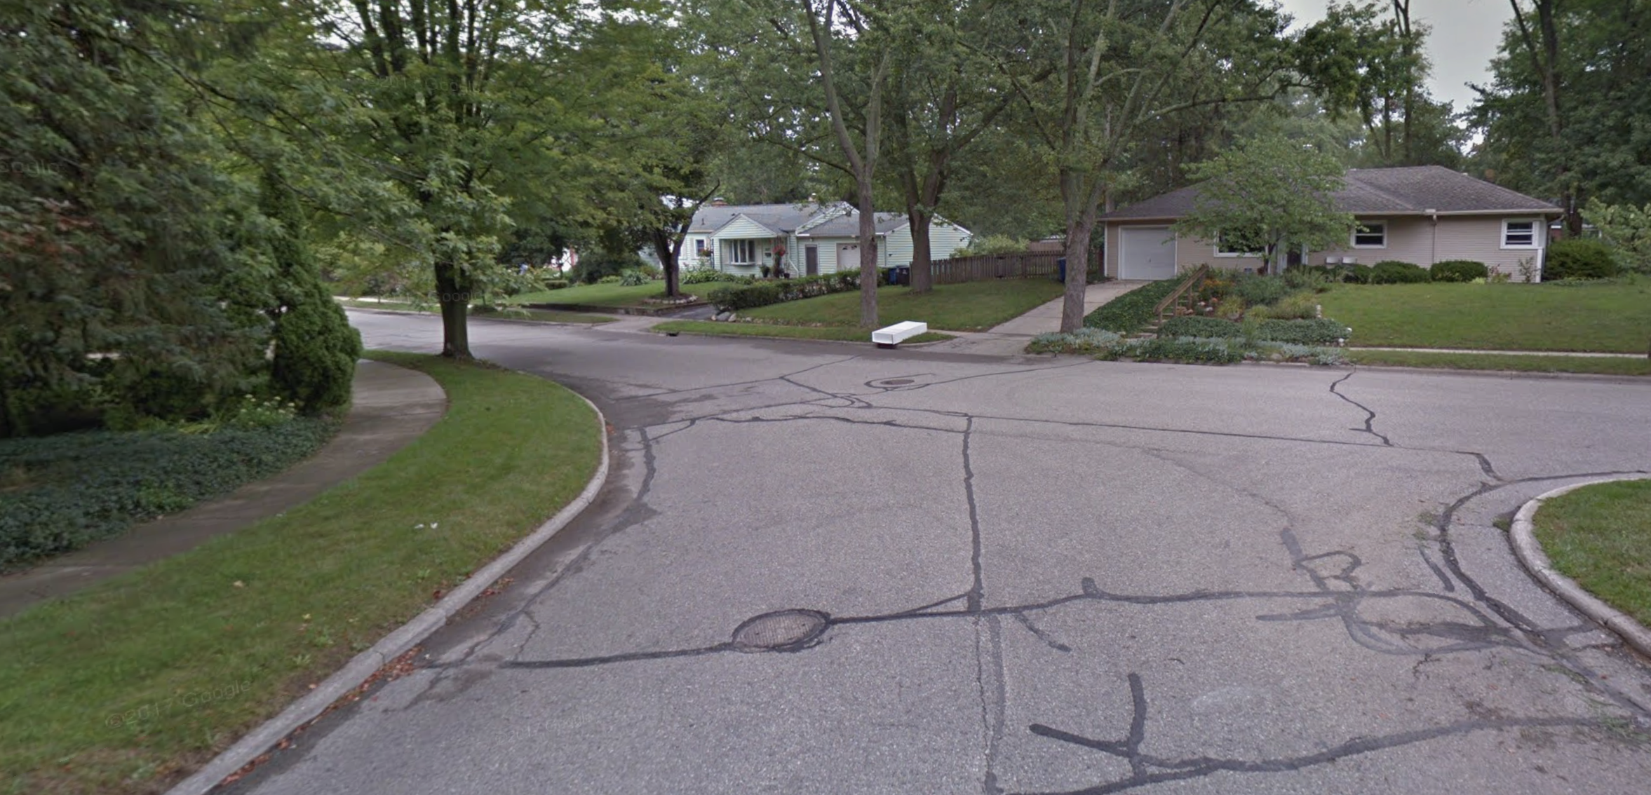
It’s Grandma and Grandpa with the dogs! I guess they’re done studying the mushroom

Slide 12
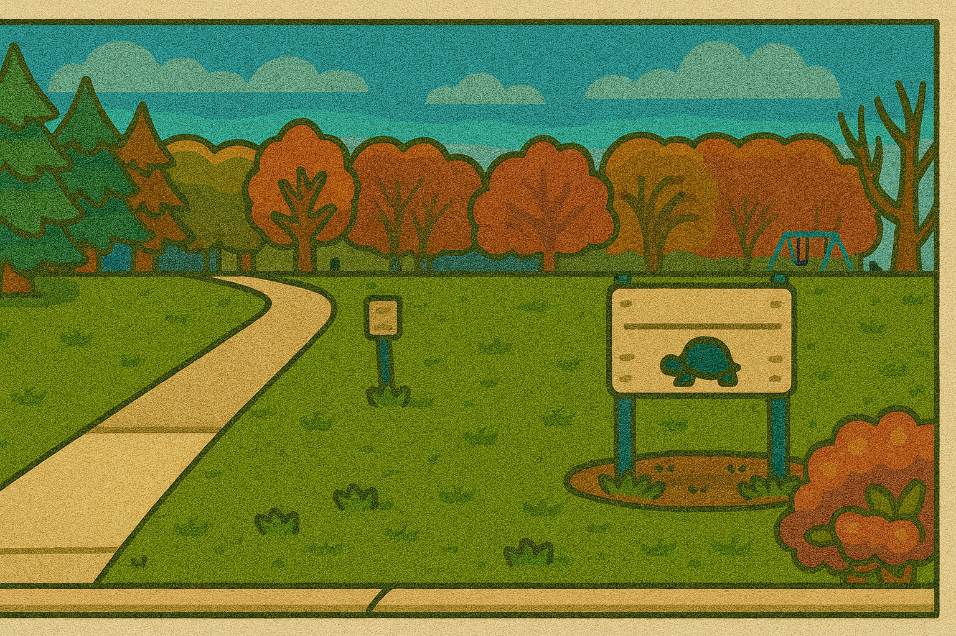
Sticks
It’s the park! There are a bunch of sticks blocking our way, though. Let’s help clean them up.
How many sticks are there, Gerties?
- Count the number out loud as they’re clicked

